Slide 1
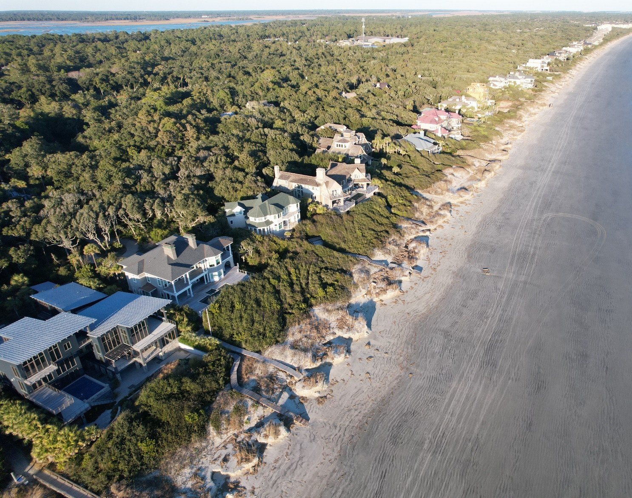
Kiawah Island
2023 Beach Monitoring
Steven Traynum
Coastal Science & Engineering
straynum@coastalscience.com

Slide 2
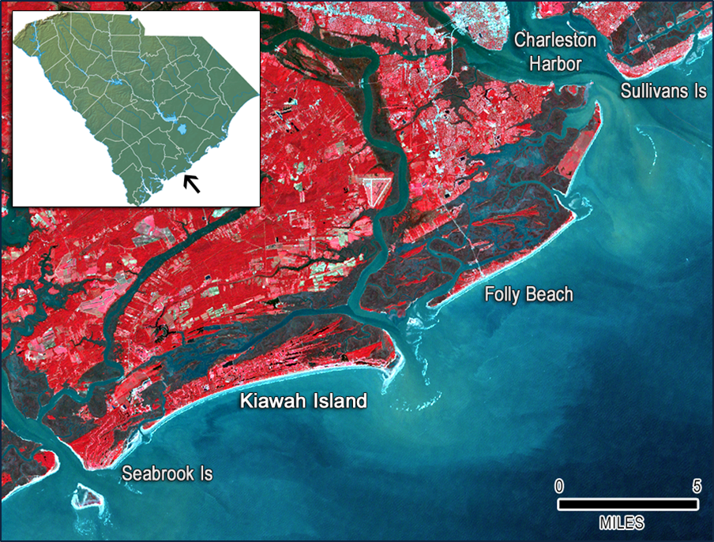
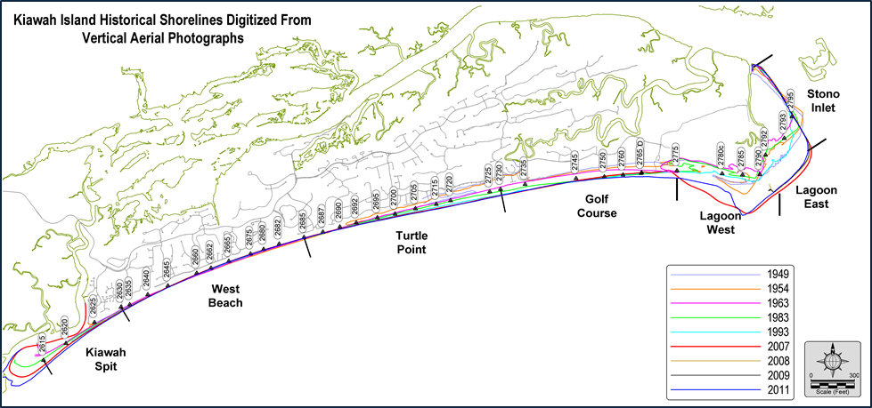
Kiawah Island
~10 miles of beach along a mostly east-west configuration
Stono Inlet to east, Captain Sams Inlet to west
Most of the island has accreted over past several decades (1-10 ft/yr)
Developed after studies of the beach processes completed

Slide 3
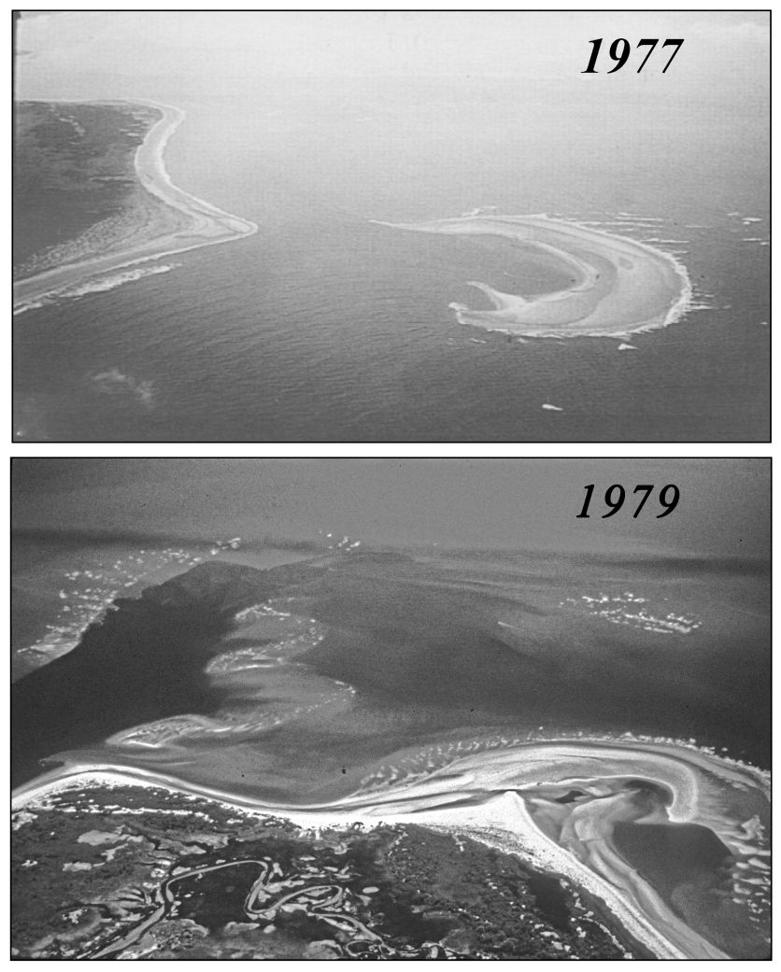
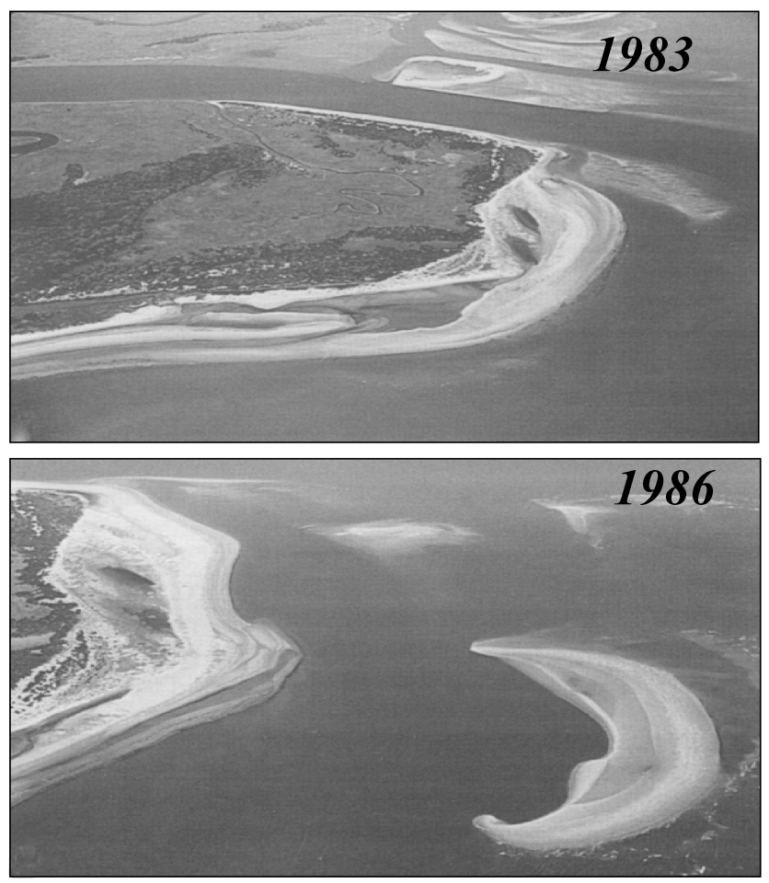
Shoal Bypassing at Stono Inlet

Slide 4
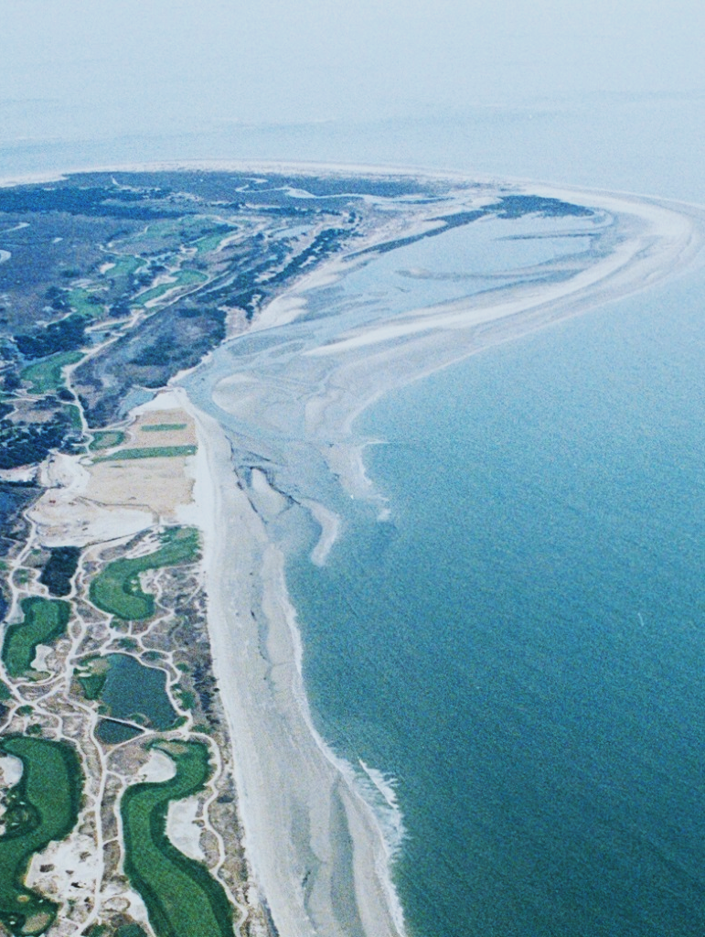
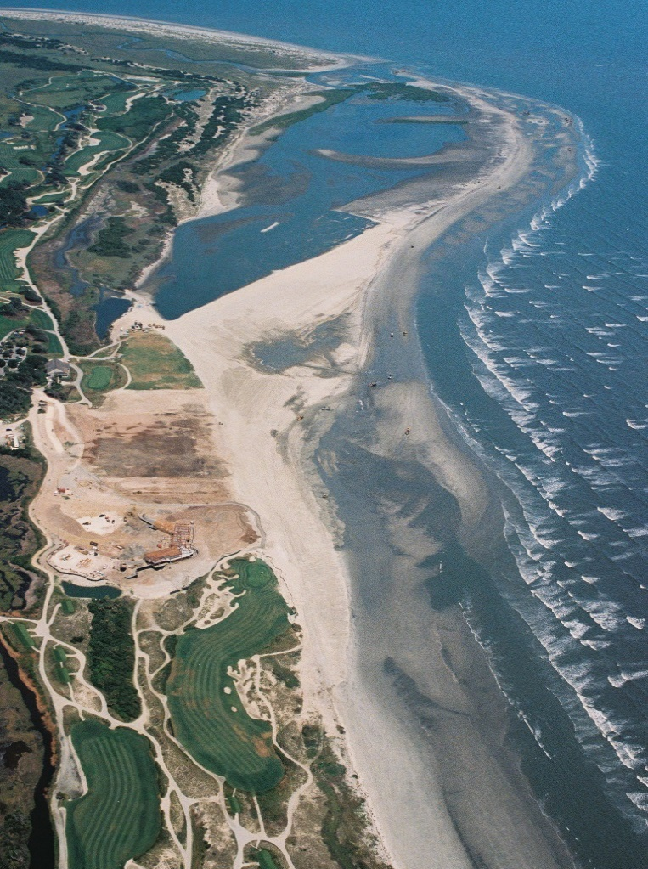
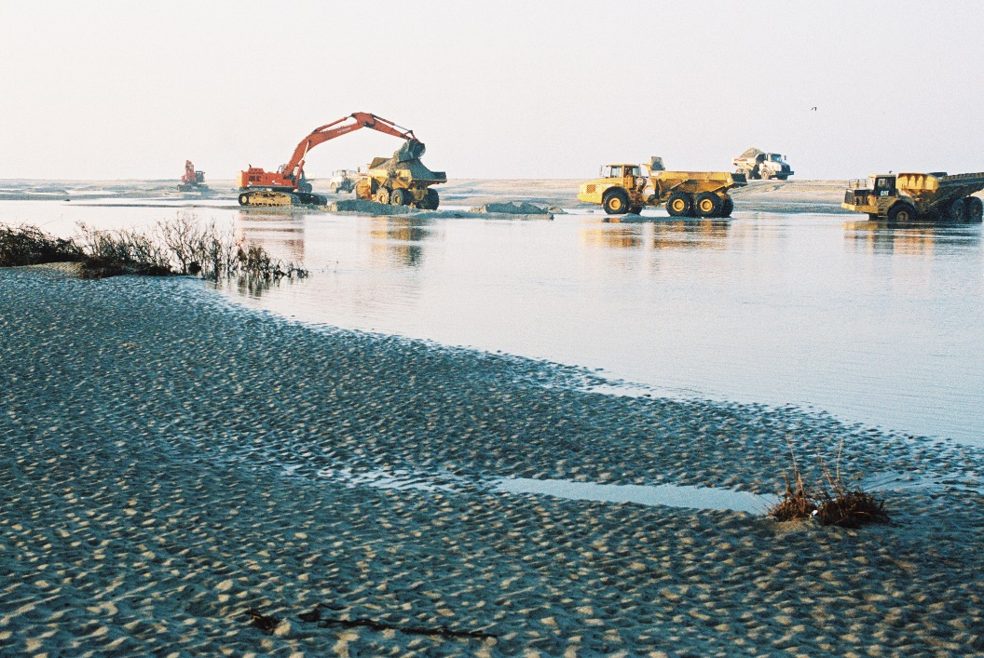
2006 Restoration Project
~550,000 cy
Inlet realignment + beach restoration
Land-based equipment
February 2006
July 2006

Slide 5
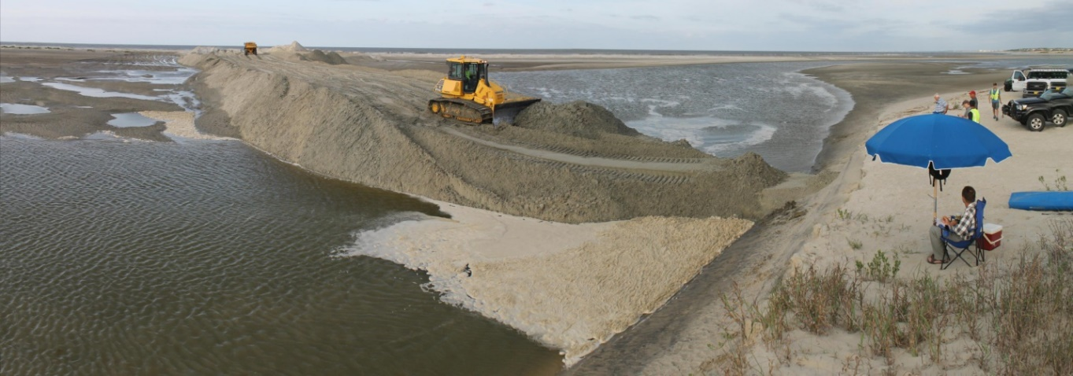
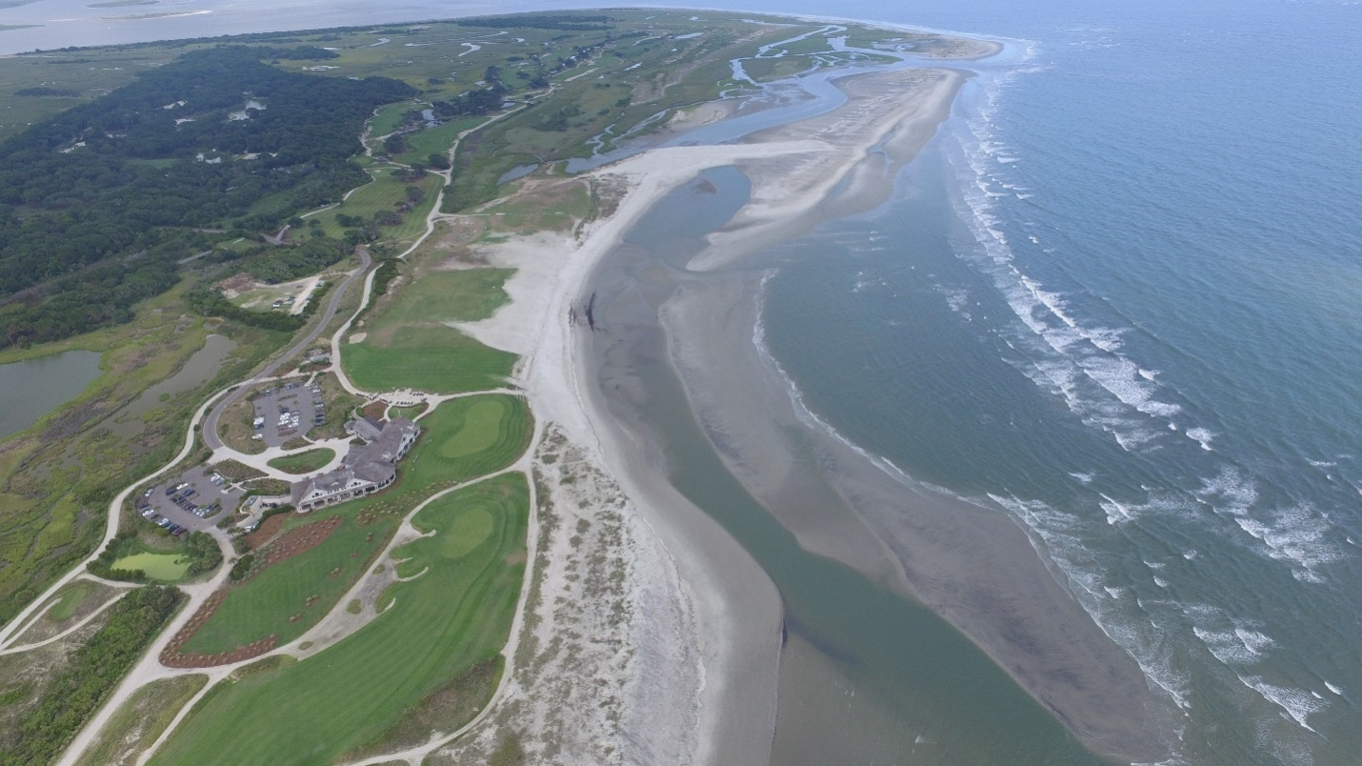
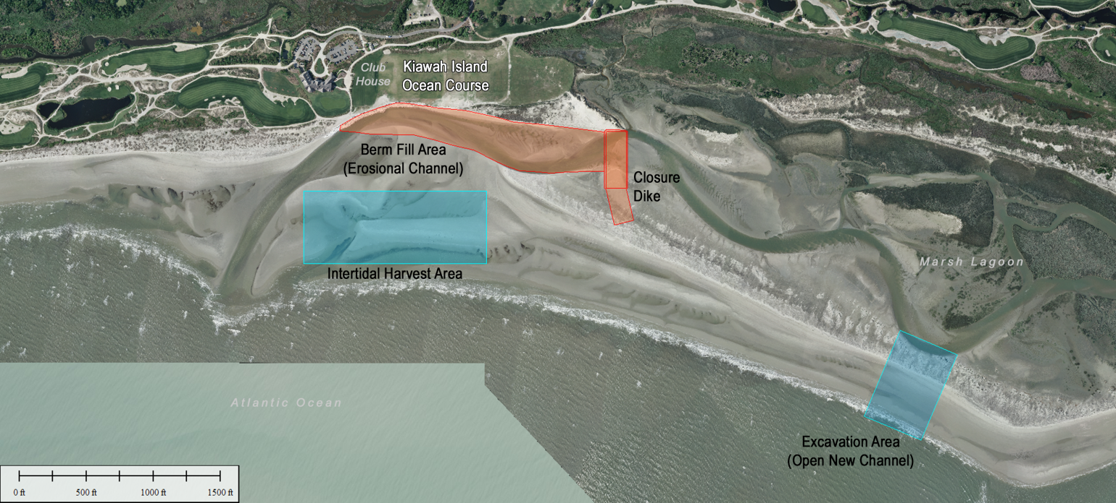
2015 Restoration Project
~100,000 cy
Limit beach restoration
Focus on habitat conservation
7 July 2015

Slide 6
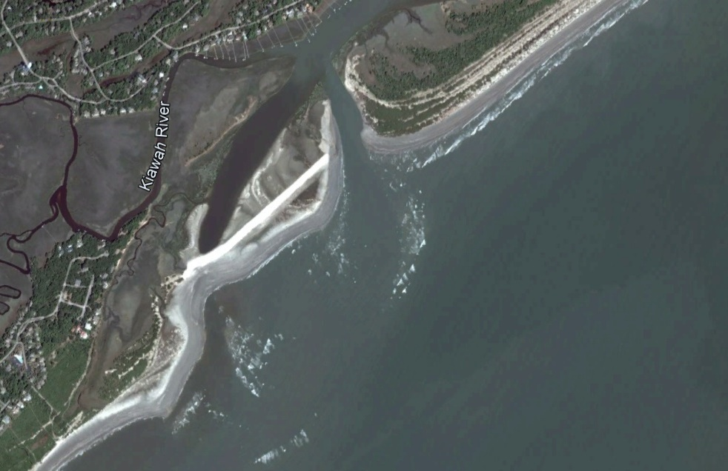
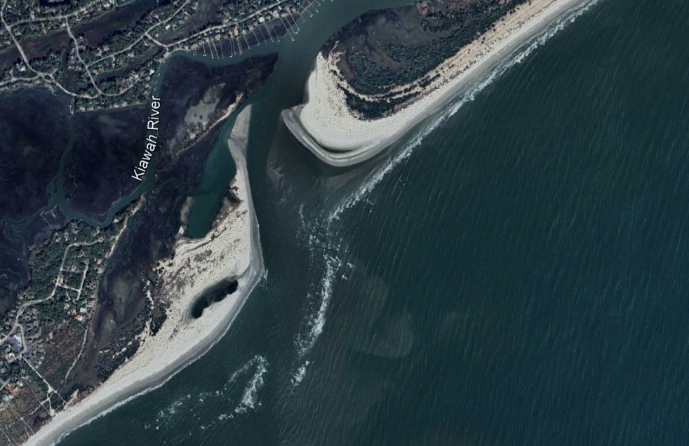
2015 Captain Sams Inlet Relocation

Slide 7
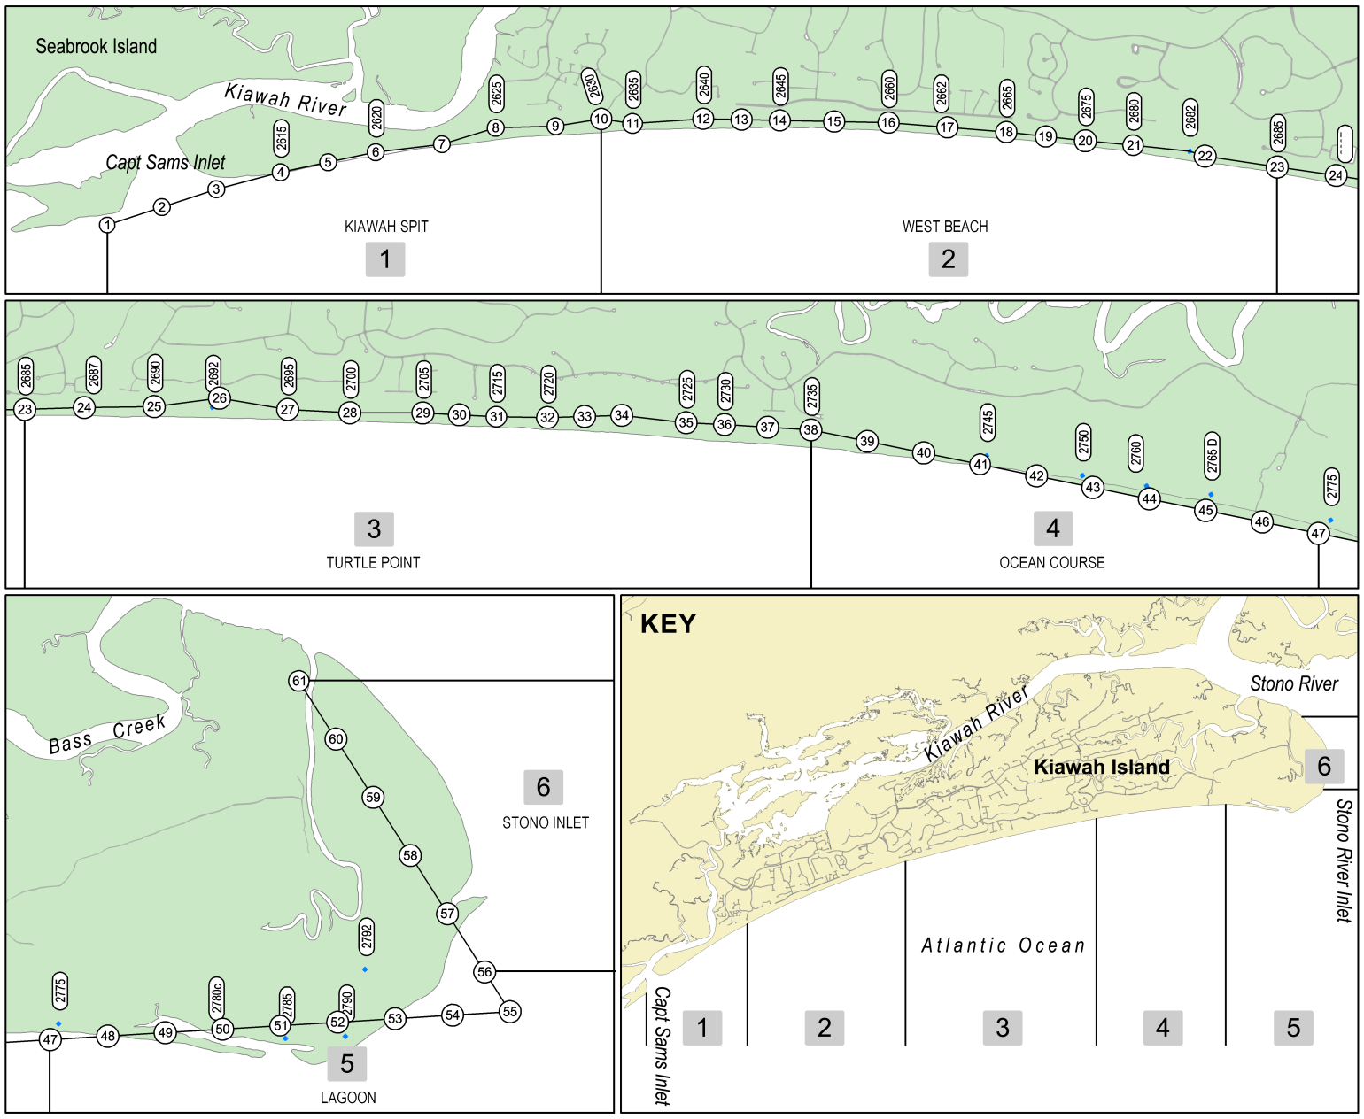
Kiawah Island Beach Monitoring
61 profiles established
  Some duplicate older OCRM series
6 reaches established
  Kiawah Spit
  West Beach
  Turtle Point
  Ocean Course
  Lagoon
  Stono Inlet

Slide 8
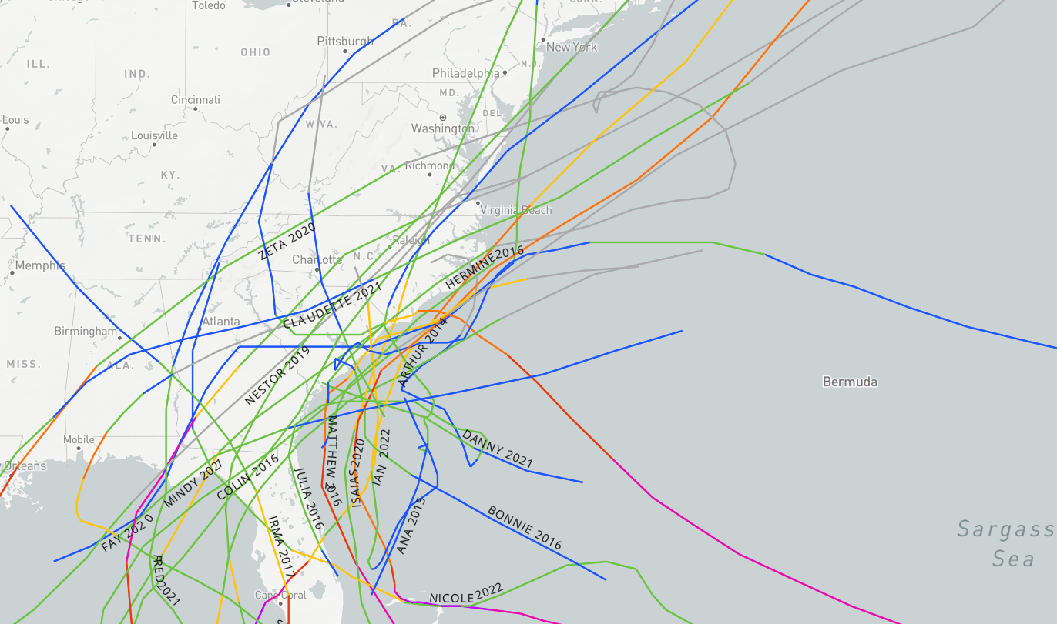
A Decade of Storms

Slide 9
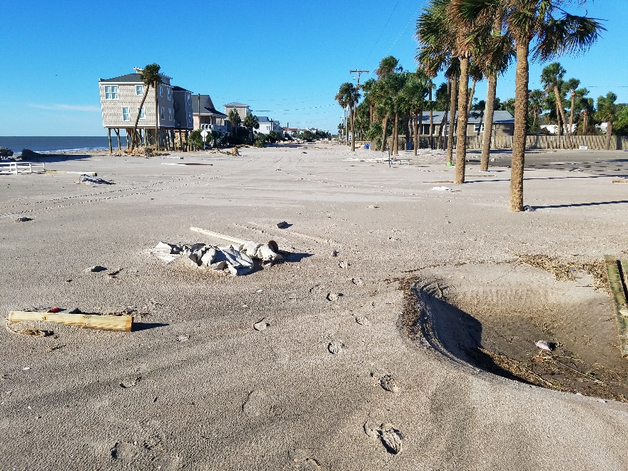
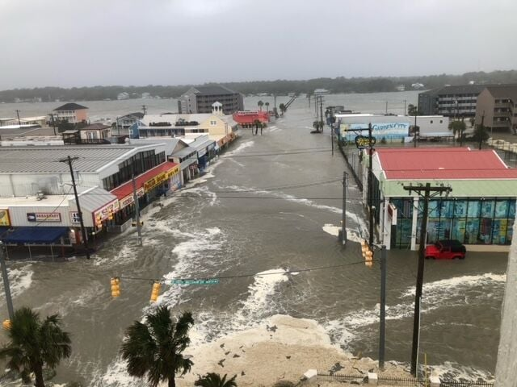
A Decade of Struggle
30 named storms – SCDNR
7 FEMA Declared Disasters
  Joaquin, Matthew, Irma, Florence, Dorian, Ian, Idalia
  Only 3 from 2000-2012 (all tropical storms in 2004)
Jante Morgan myhorrynews.com
Edisto Beach following Hurricane Matthew 2016
Garden City Beach During Hurricane Ian

Slide 10
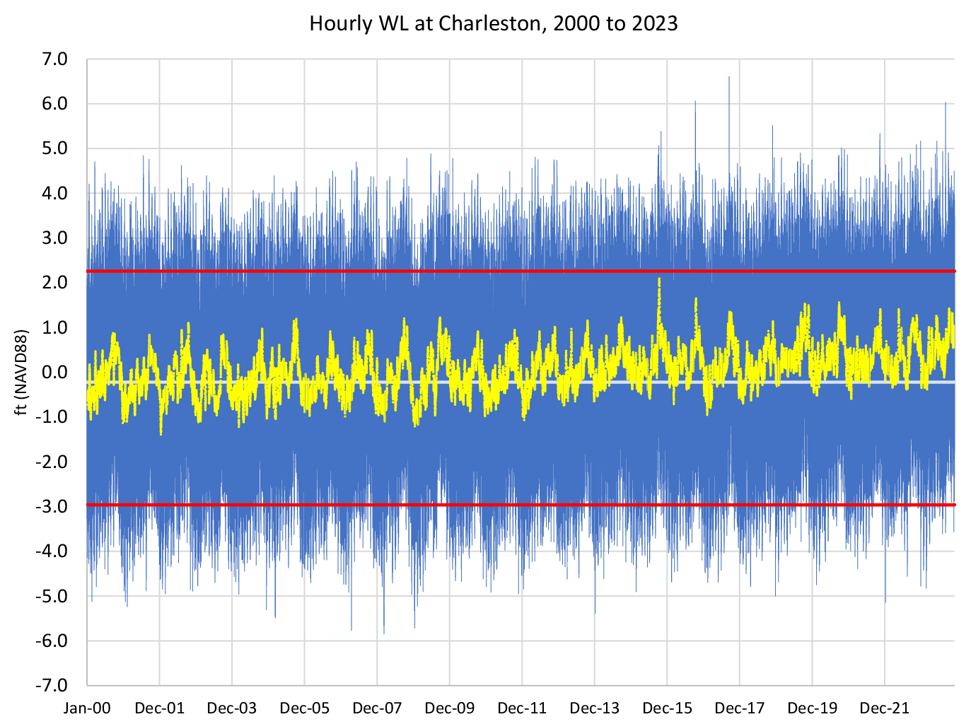
A Decade of Sea Level Rise

Slide 11
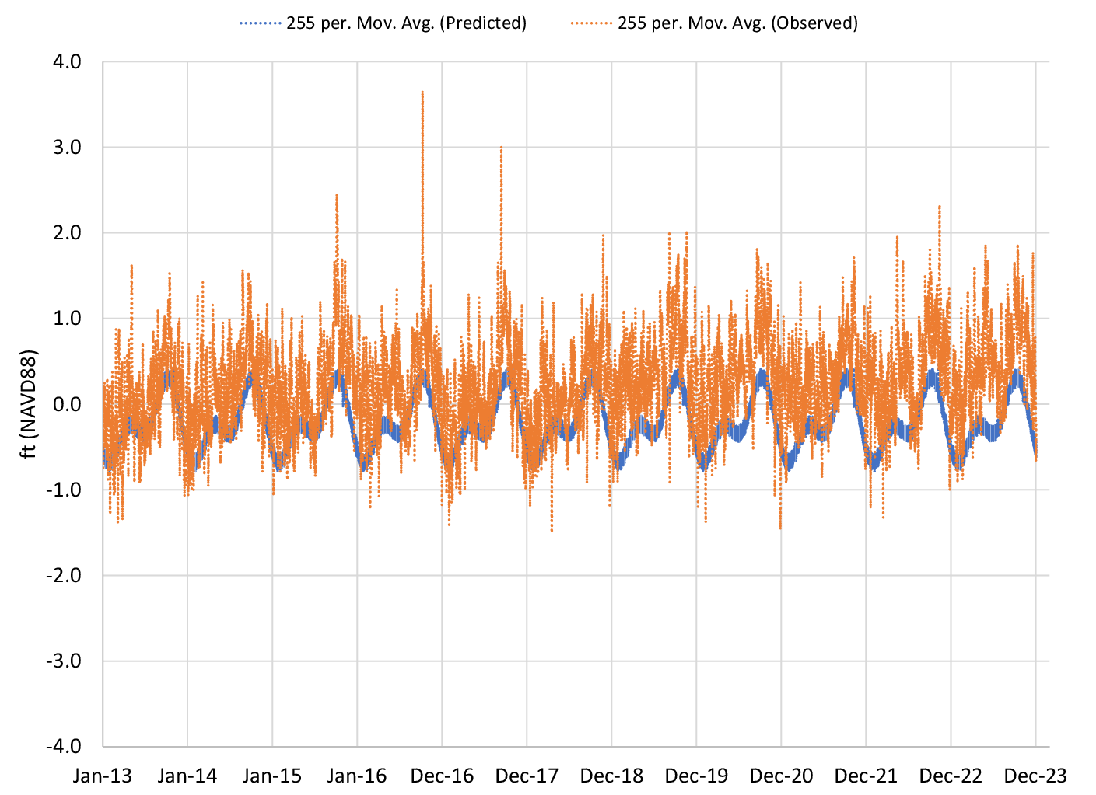
Observations vs Predictions – ‘6-minute'
Charleston

Slide 12
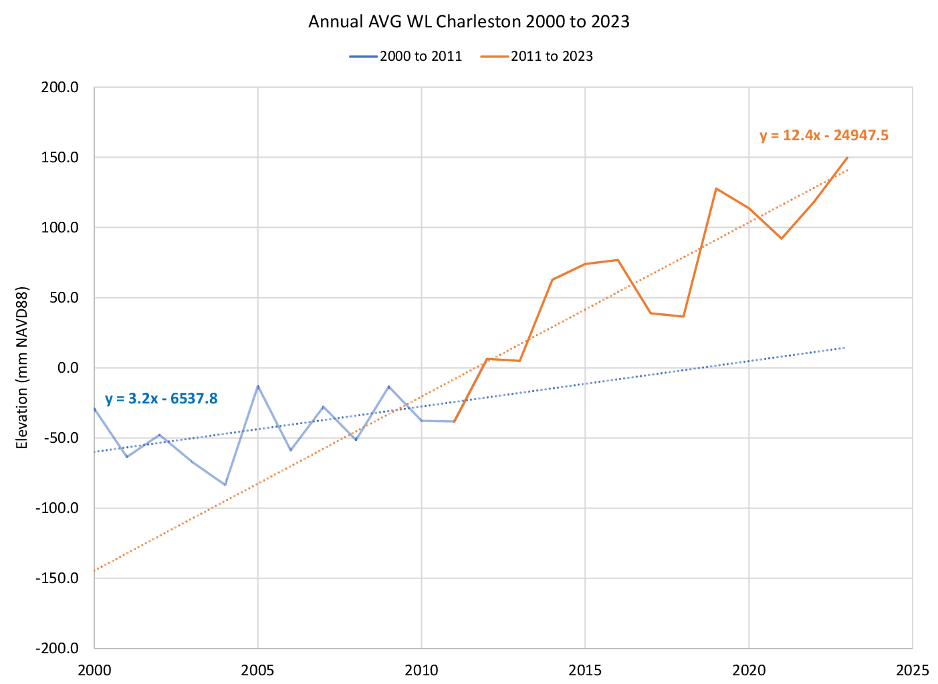
Observations – ‘hourly’
Charleston

Slide 13
Beach Volume Change – Nourishments Removed

Slide 14
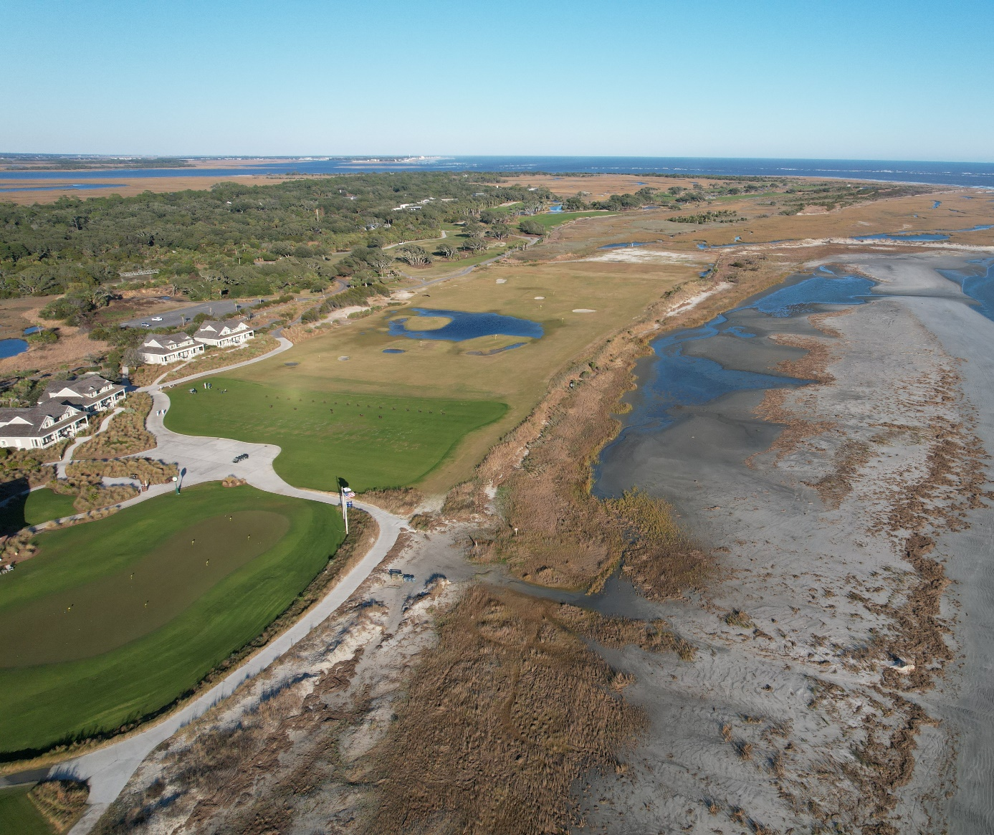
Kiawah Island
Key Events 2022-2023
  Shoal Attachment
  Hurricane Idalia
  December 2023 Nor’easter
    4th Highest water level on record

Slide 15
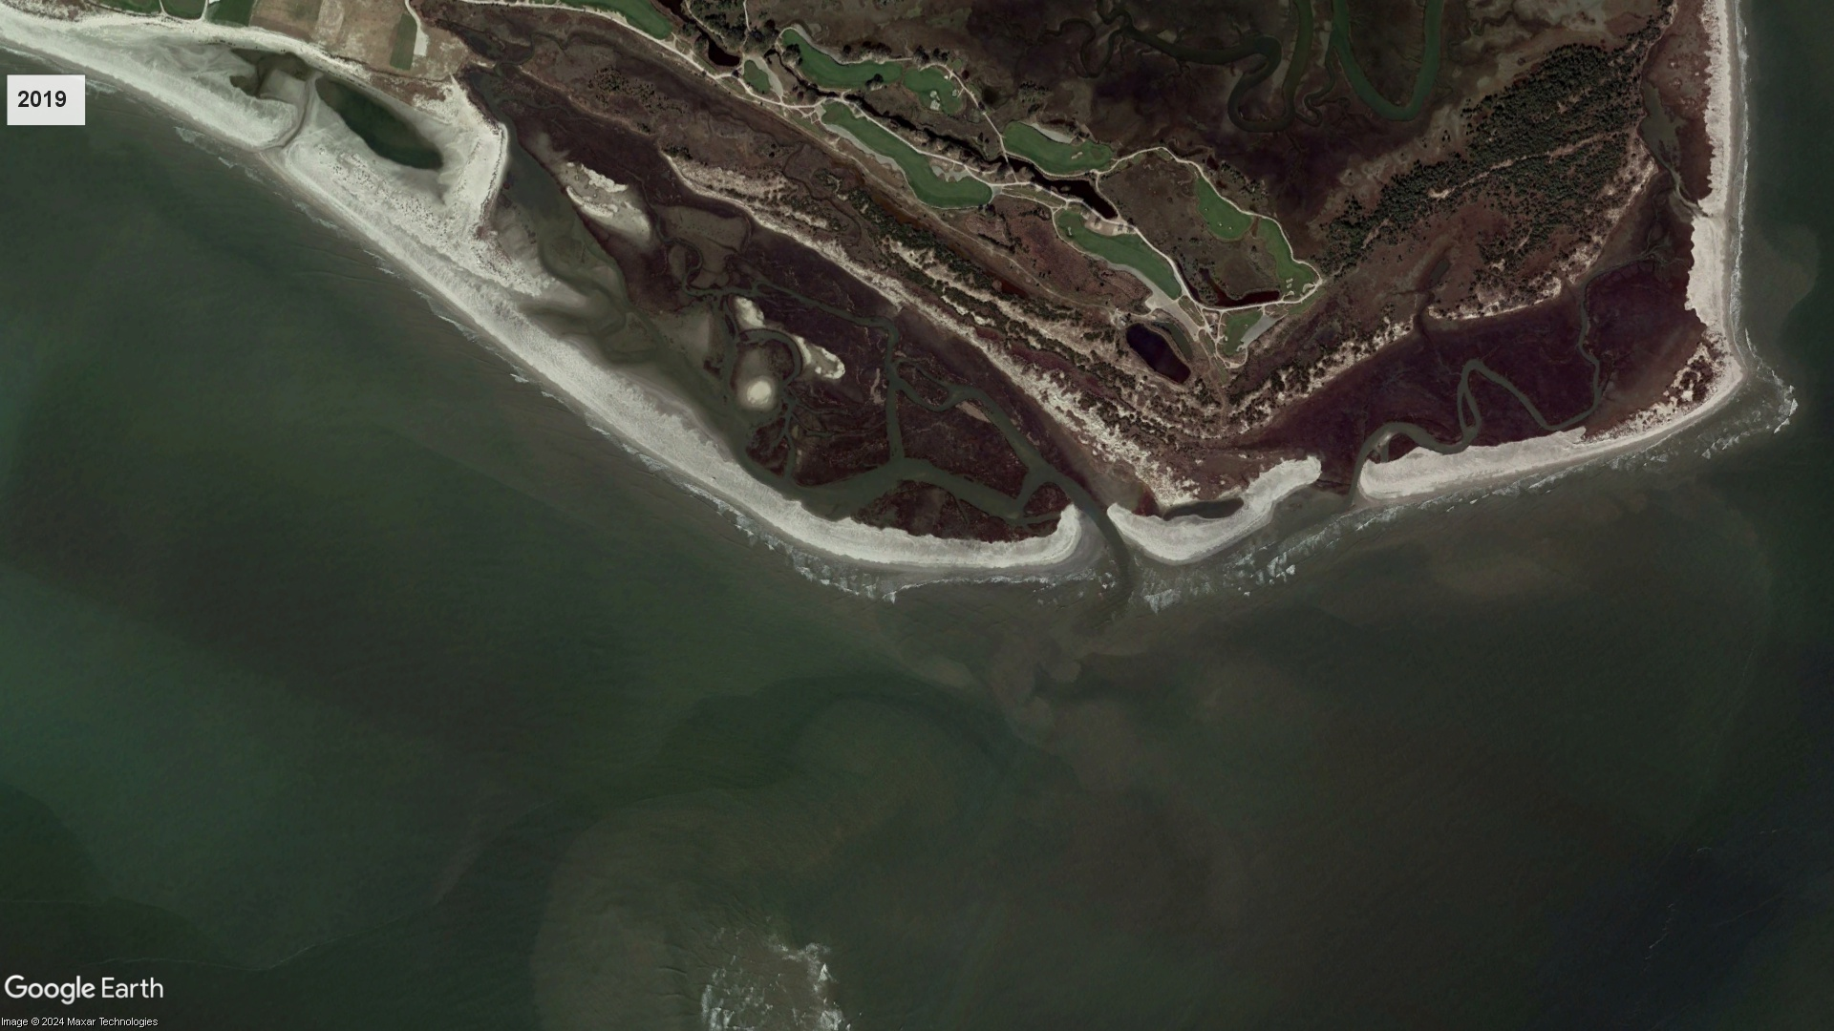
Shoal bypassing 2019-2023

Slide 16
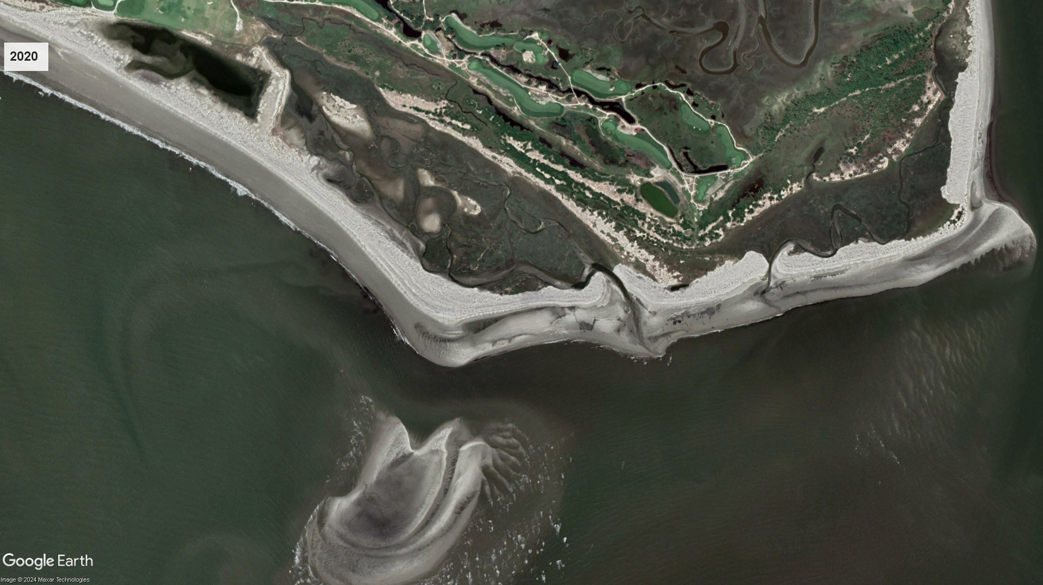
Shoal bypassing 2019-2023

Slide 17
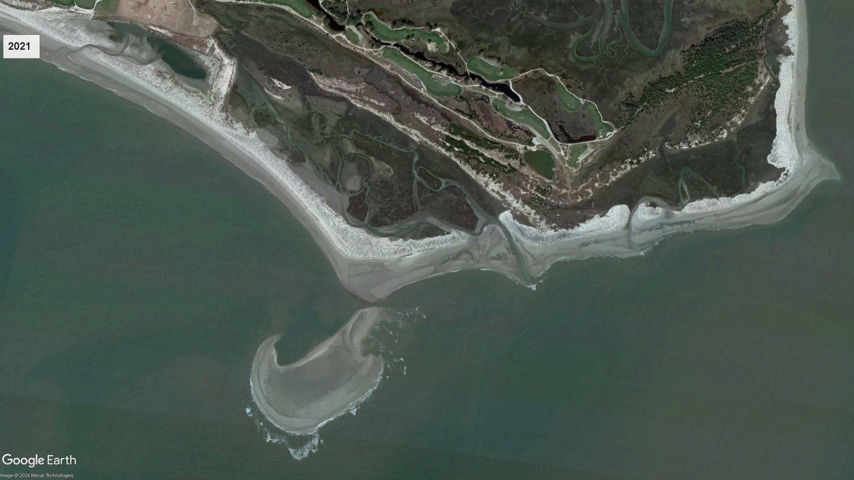
Shoal bypassing 2019-2023

Slide 18
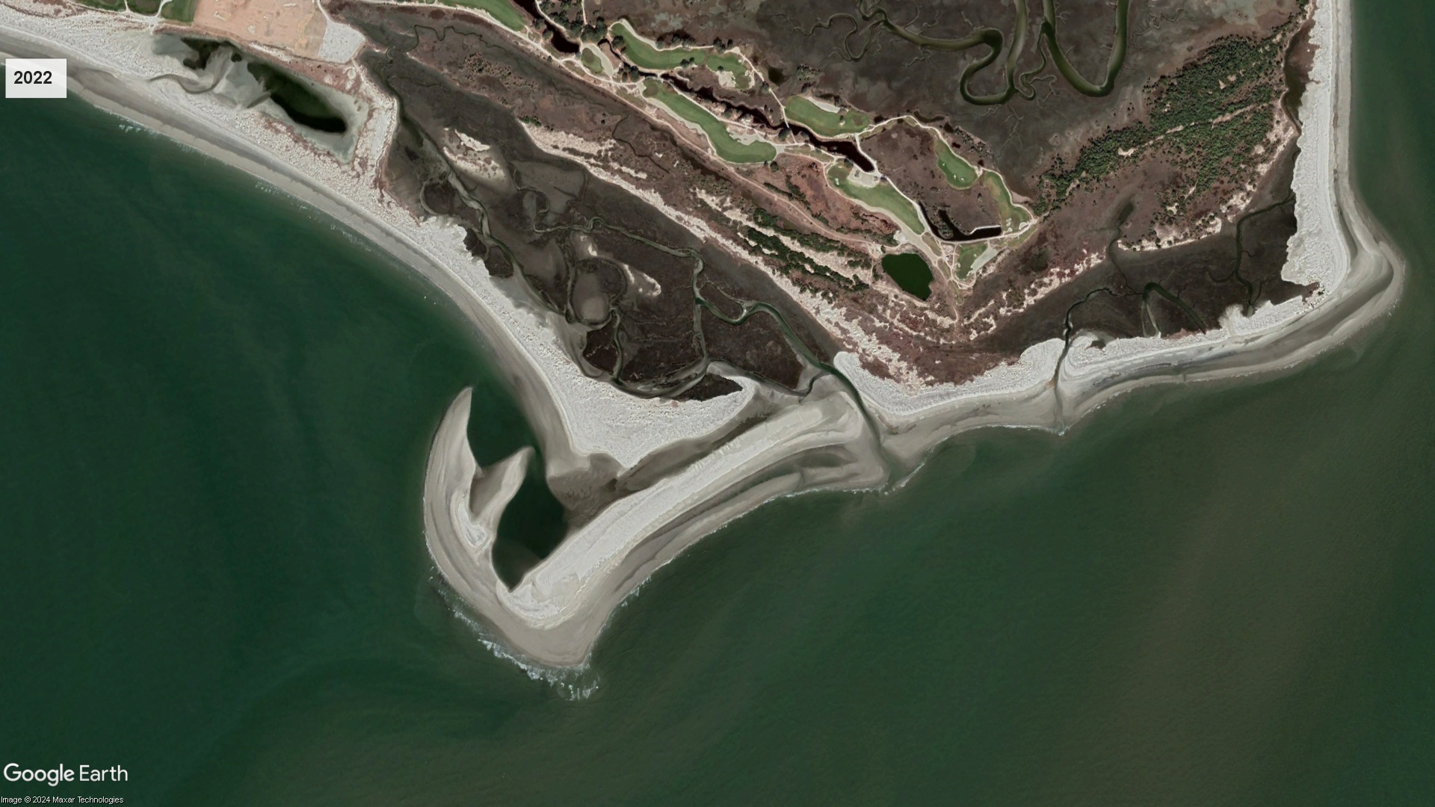
Shoal bypassing 2019-2023

Slide 19
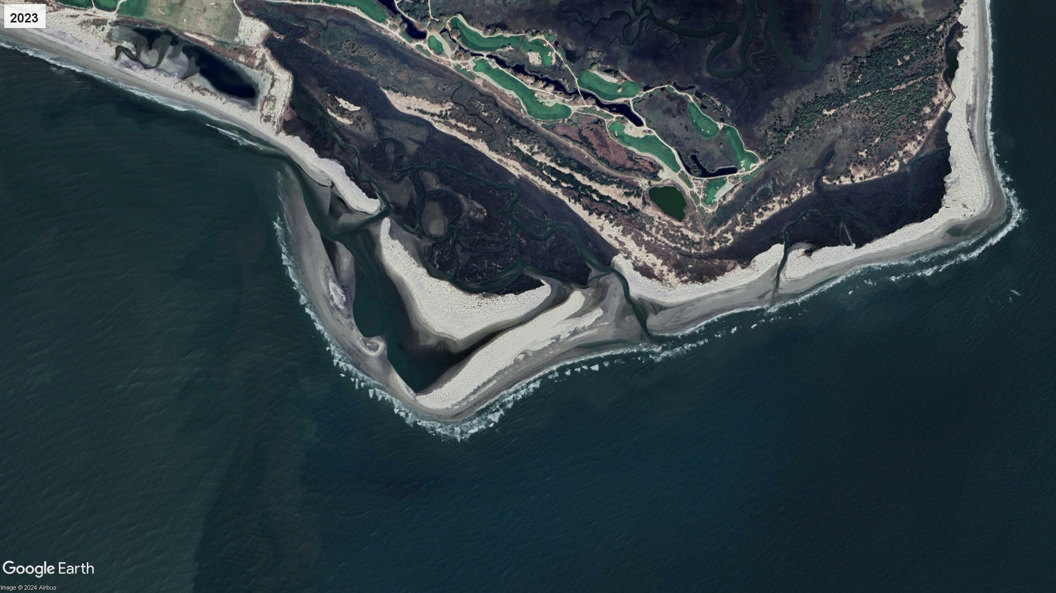
Shoal bypassing 2019-2023

Slide 20
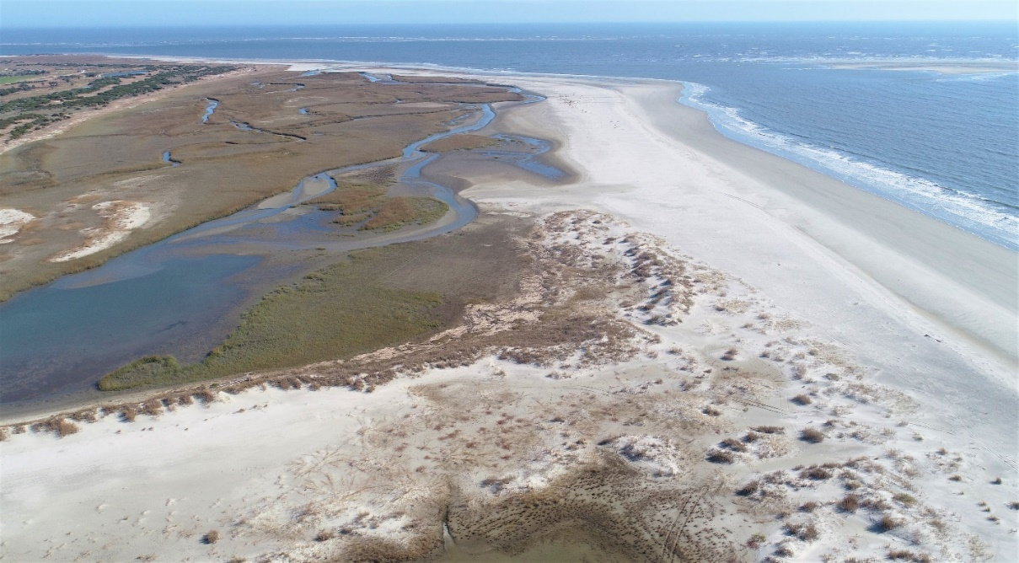
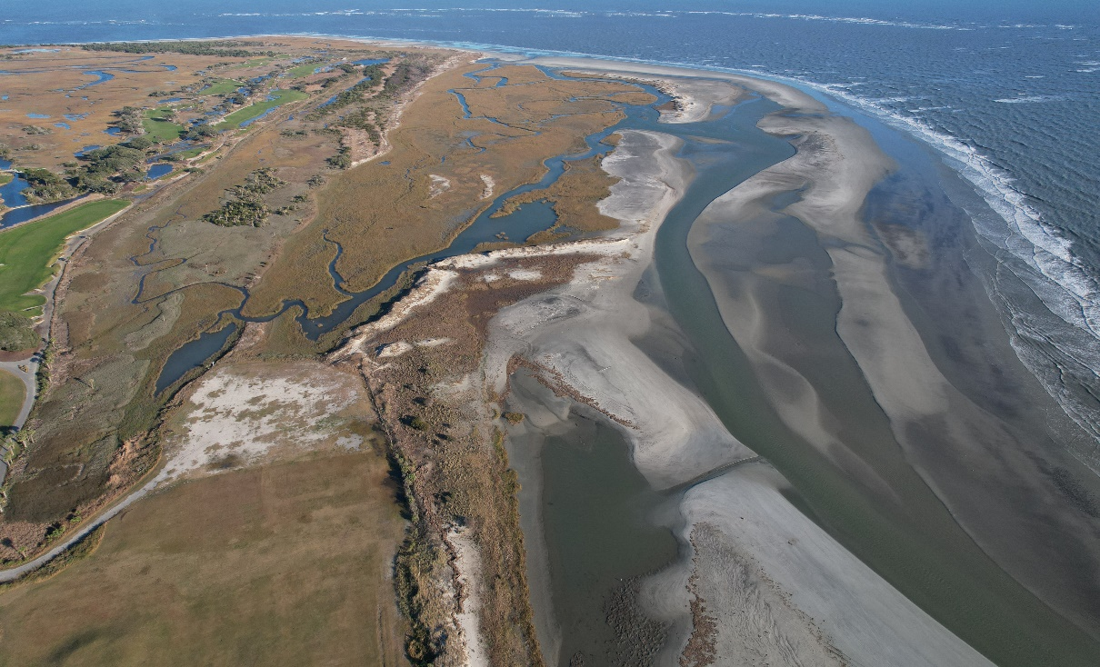
Kiawah Island
Channels 1&2
May 2015 Channel
Key Events – East End
  2015 project channel completely shoaled in
    Blue arrows indicate post-project migration
  Three new drainage channels opened since ~2016
    Channel 1 (Hurricane Matthew)
    Channel 2 (Hurricane Irma)
    Channel 3 (Hurricane Dorian)
  2023 – Channel Southerly Migration
Channel 3
June 2016
July 2017
March 2018
2015 Dike

Slide 21
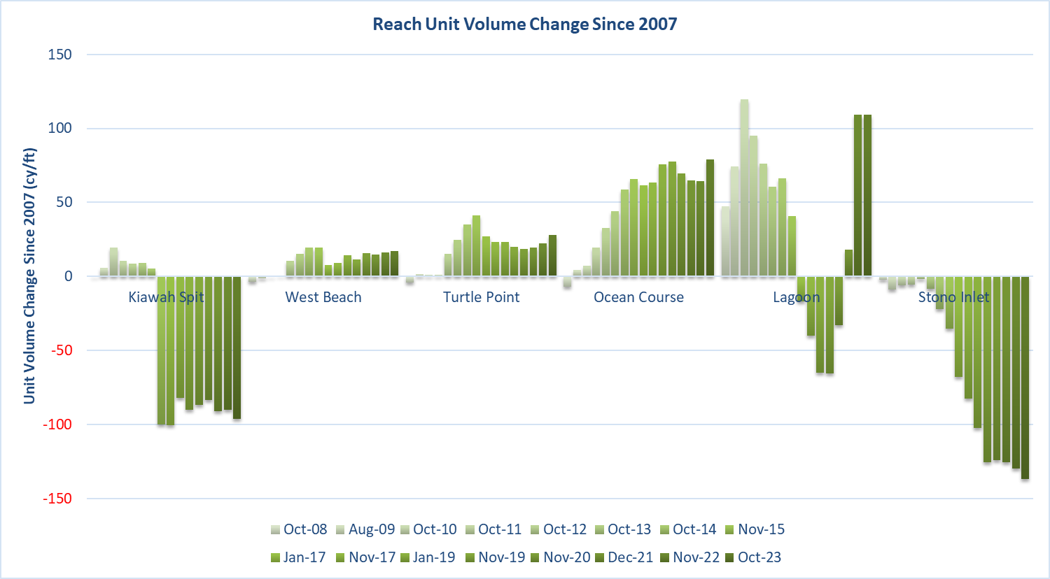

Slide 22
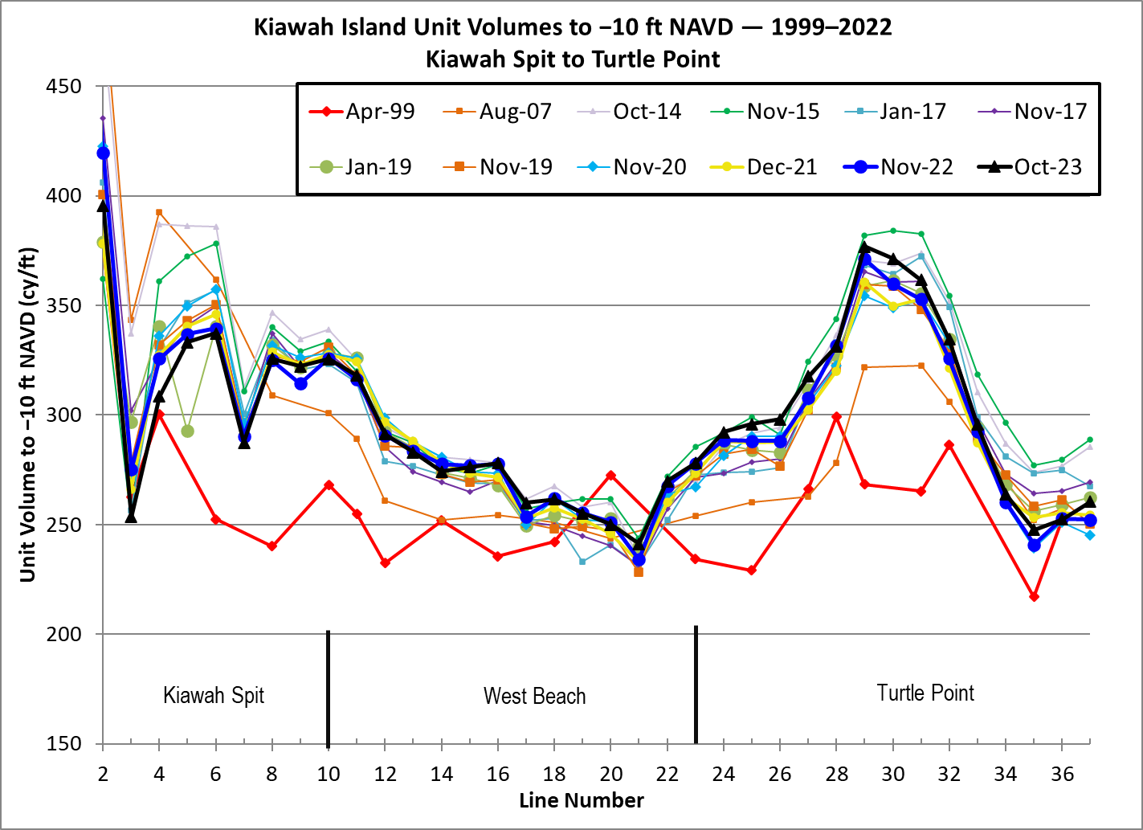

Slide 23
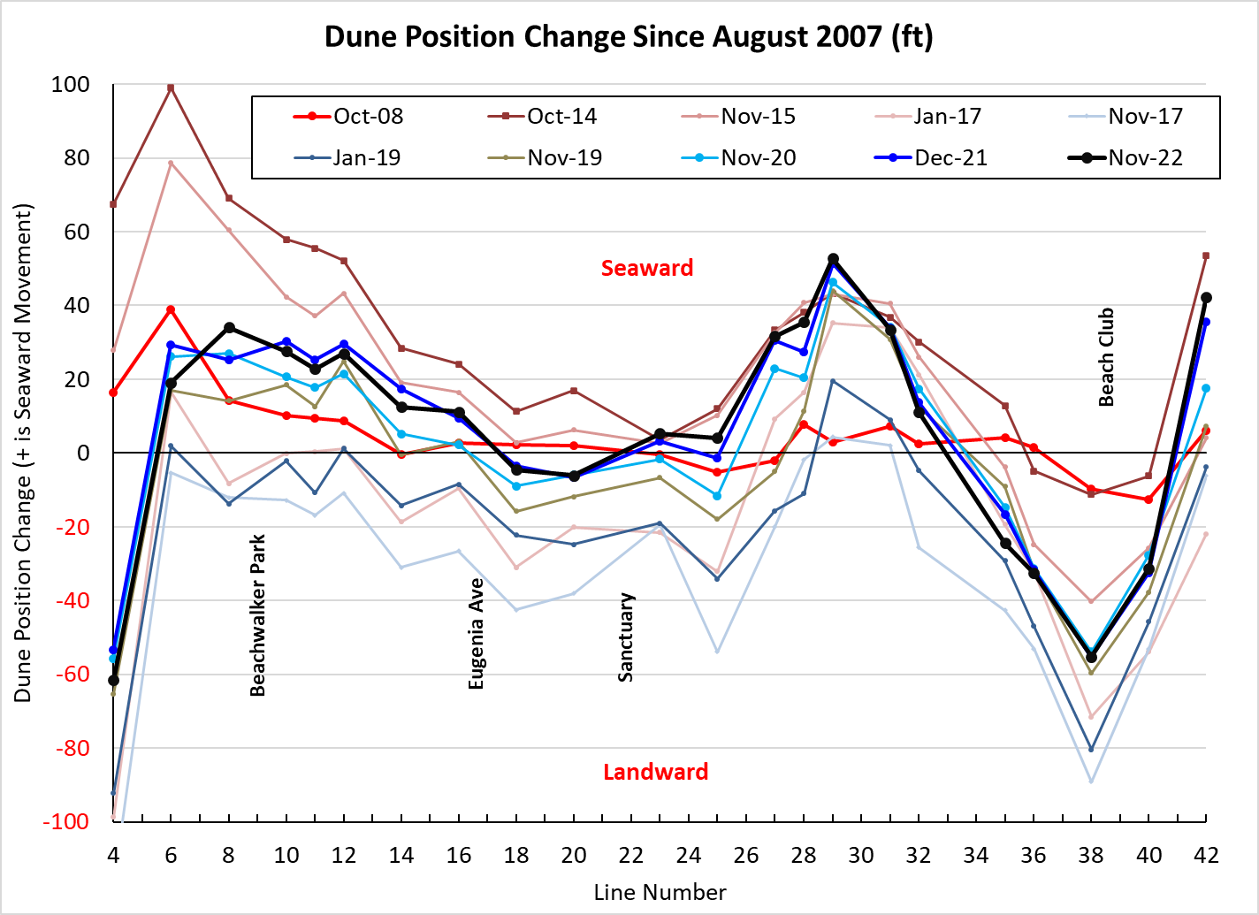
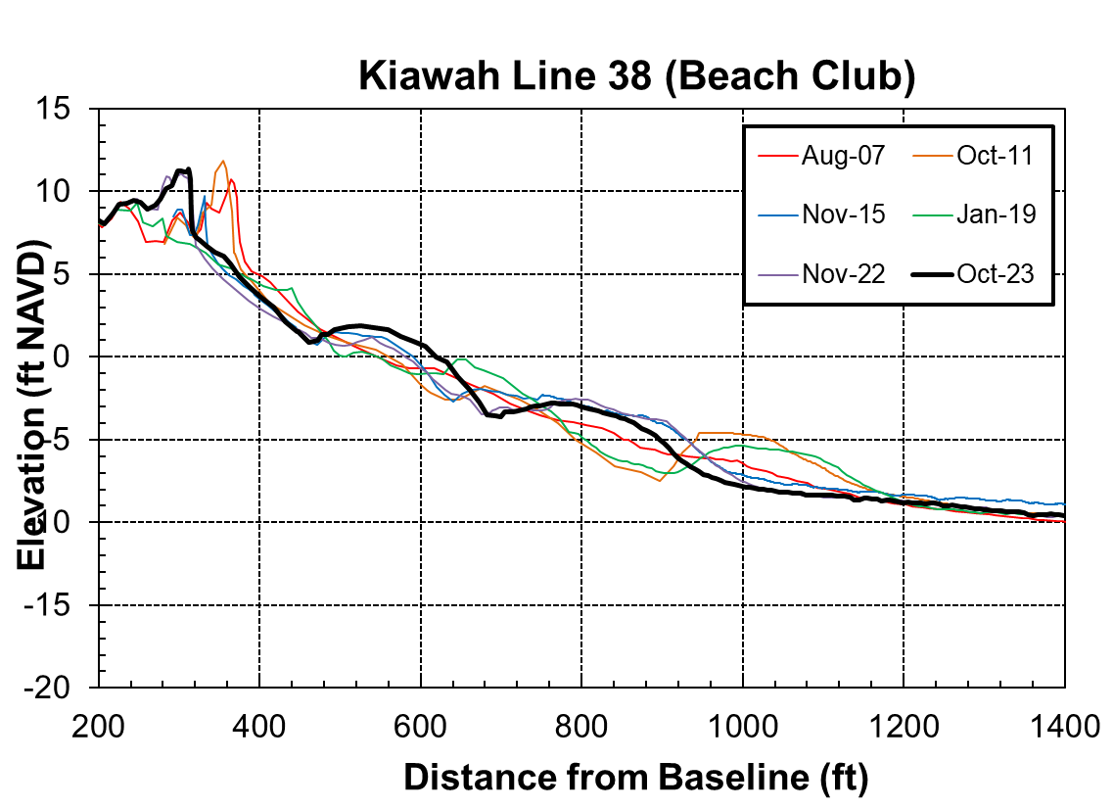
Kiawah Island
Shoreline Position Change Through 2022

Slide 24
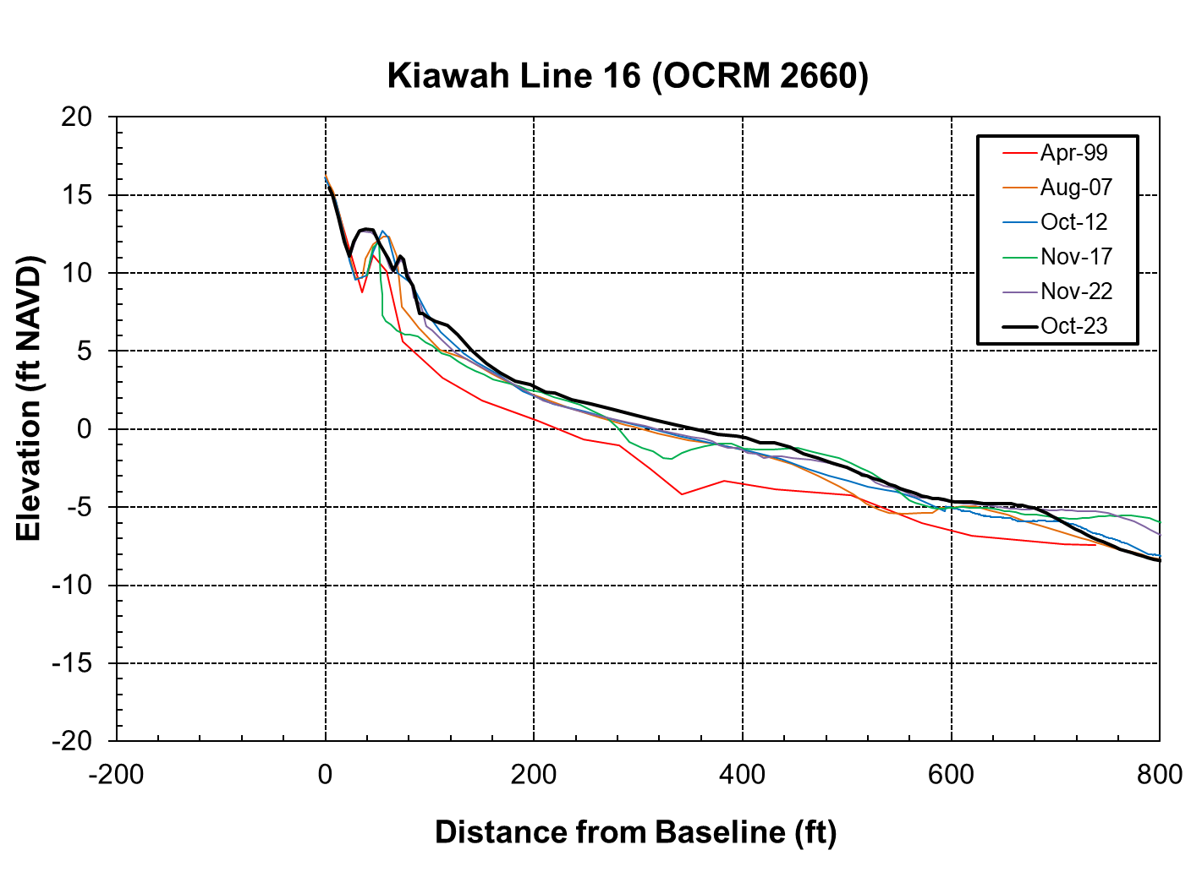
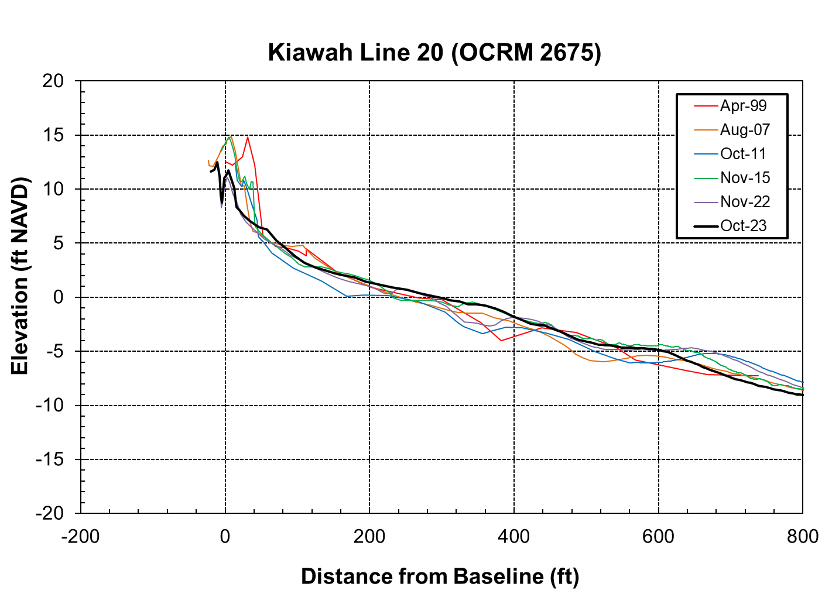
Beach Profiles
Eugenia Ave
Sea Forest Dr

Slide 25
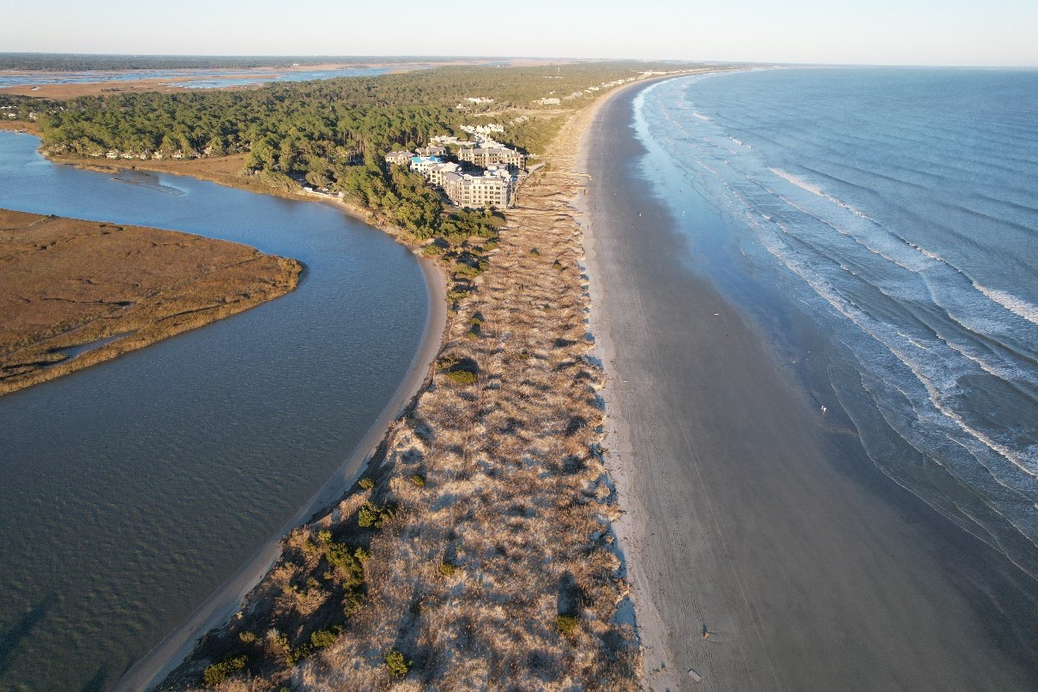
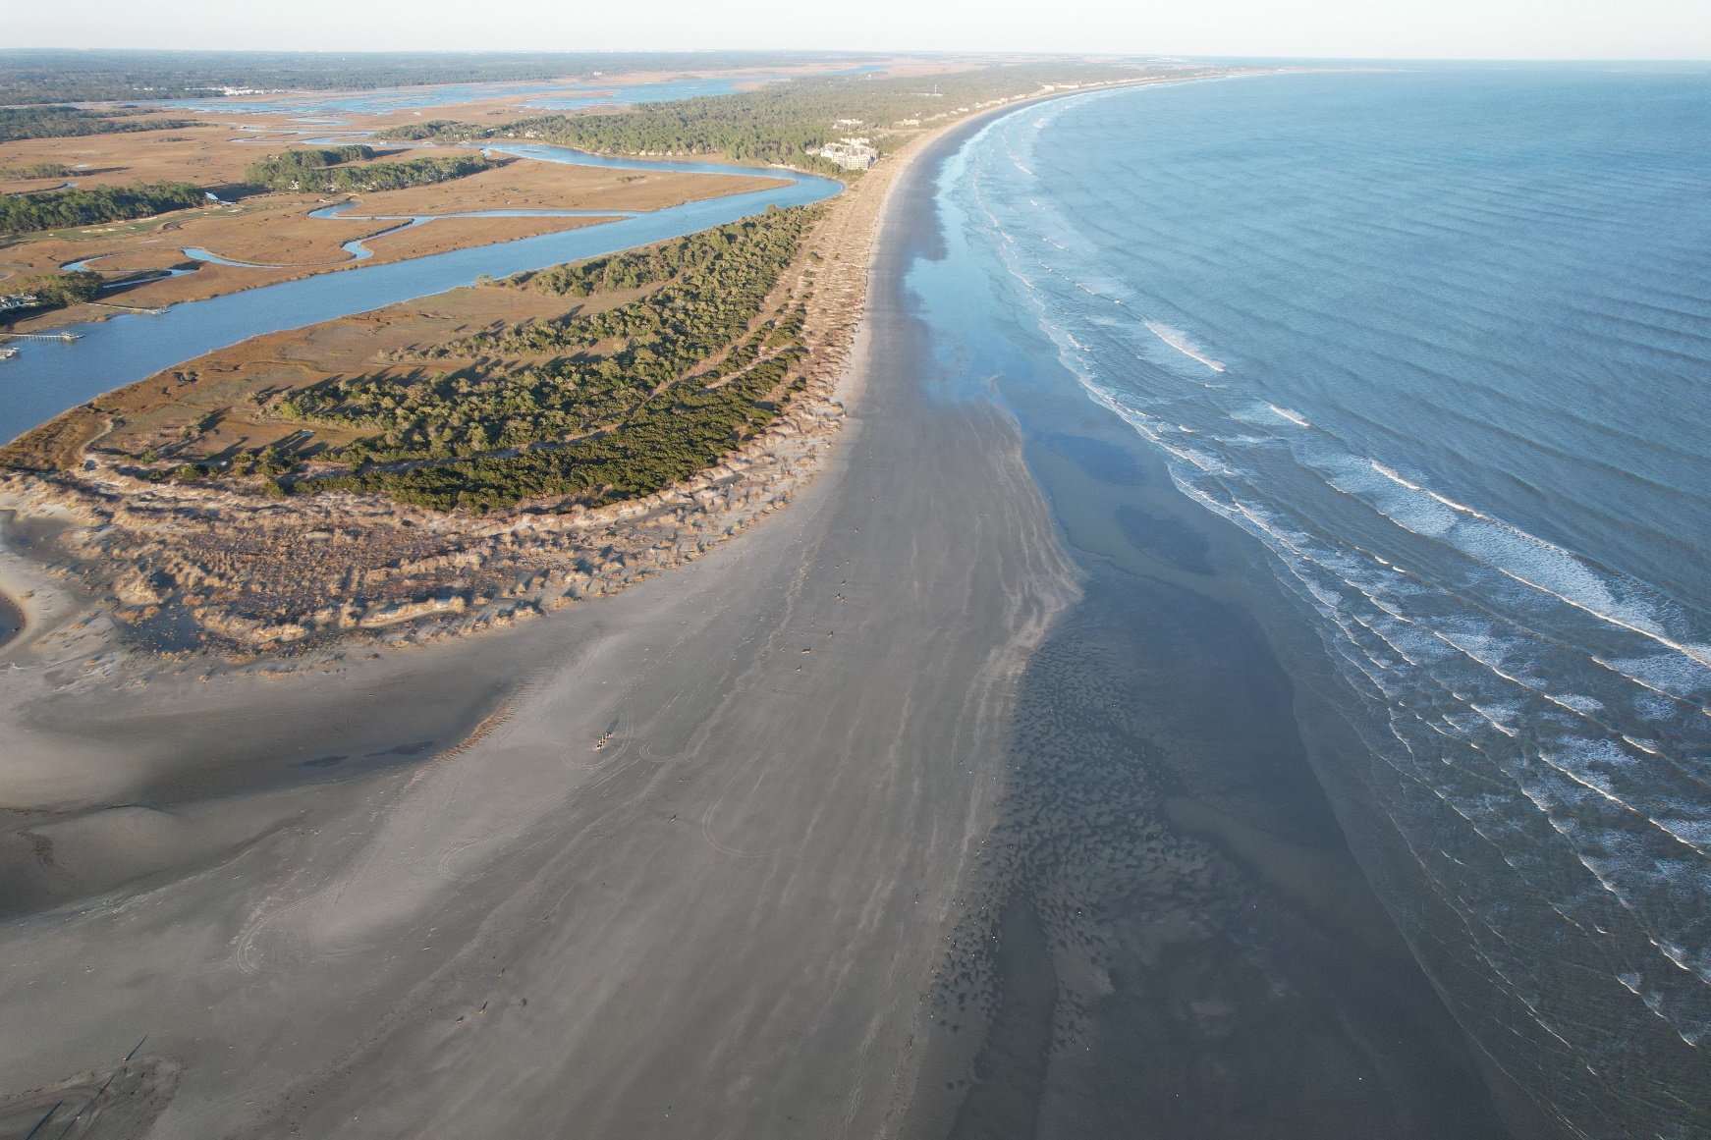
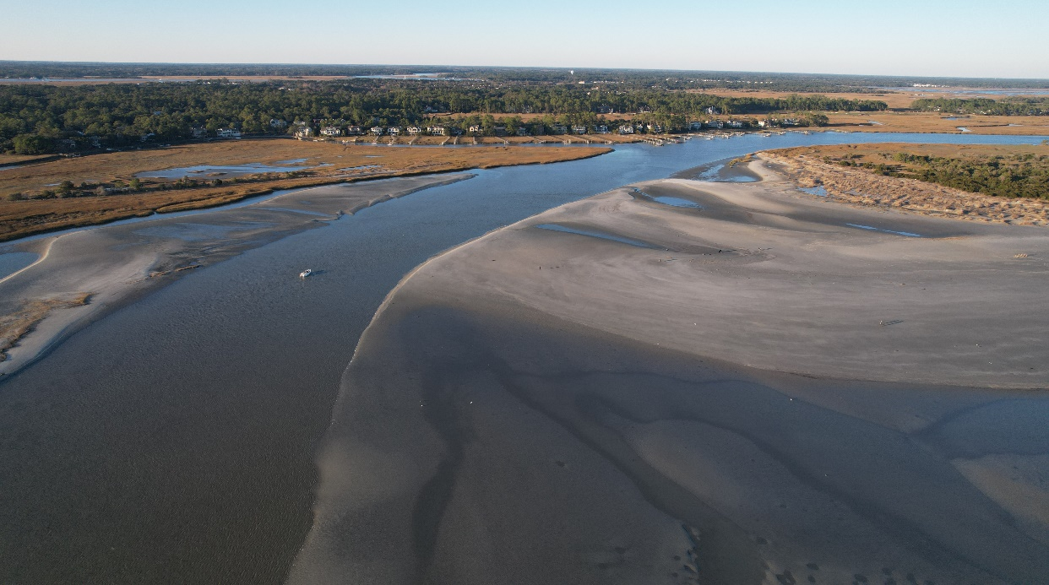
Captain Sams Spit

Slide 26
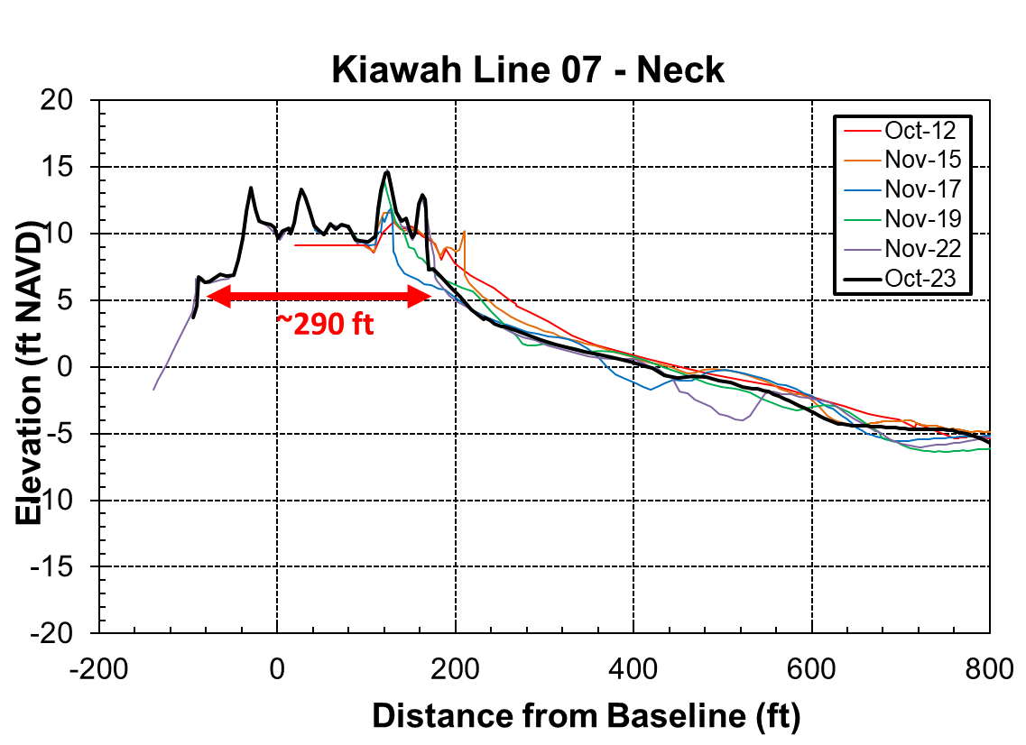
Kiawah Spit – Beachwalker Park
Only ~290 ft of upland area separates Kiawah River and the ocean
Both shorelines have eroded over the past 10 years

Slide 27
Volume Change Summary
Overall, Island has gained ~500,000 cy of sand in last ~15 years
West Beach and Turtle Point have been more erosional since 2015
Ends of the island are highly dynamic

Slide 28
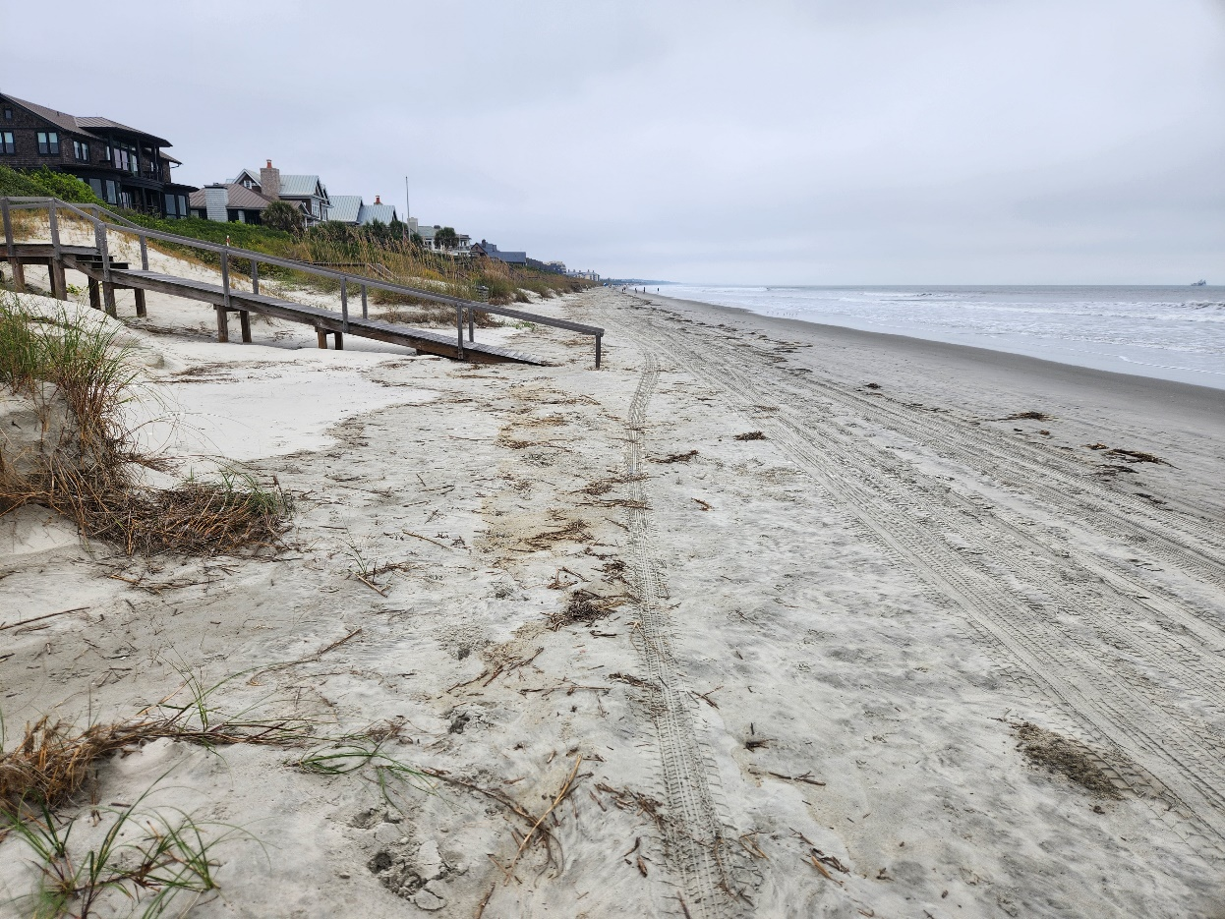
Summary
Historic patterns still hold, but recent erosional trends could persist into the future
Higher rates of erosion observed since 2015
Eugenia Ave, Mariners Watch are most vulnerable
Town should be prepared for storm recovery along vulnerable areas
East end channel realignment permit

Slide 30
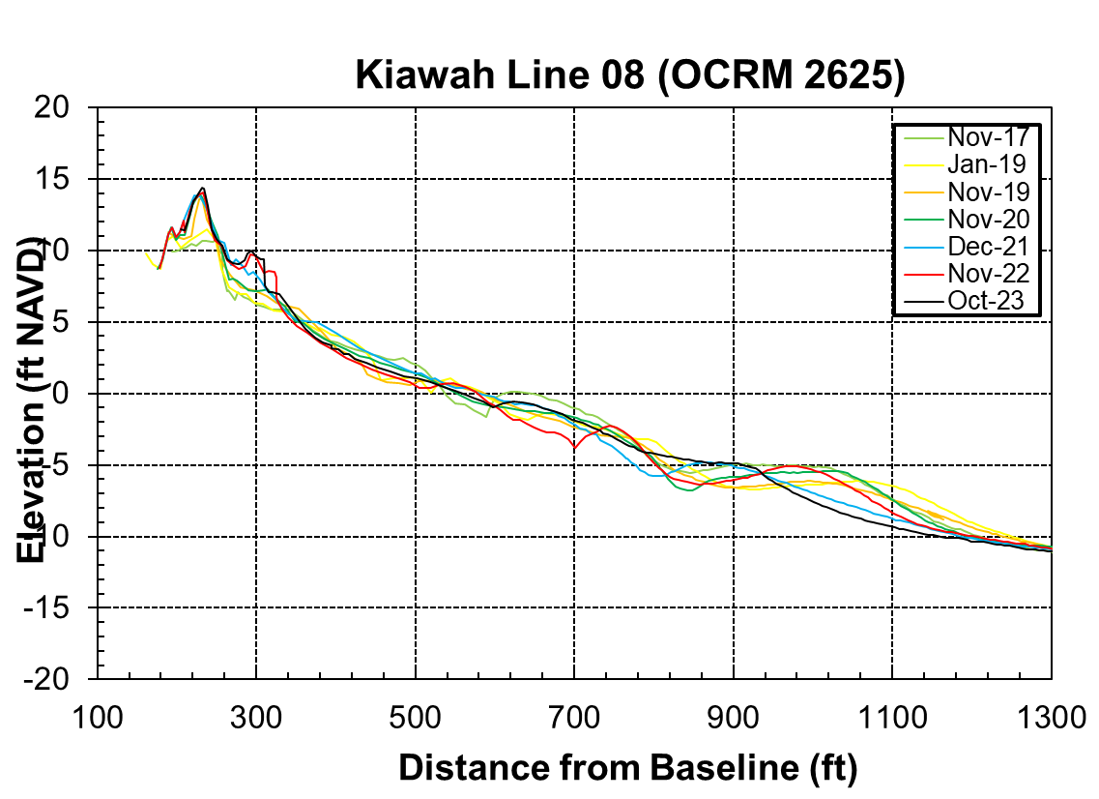

Slide 31
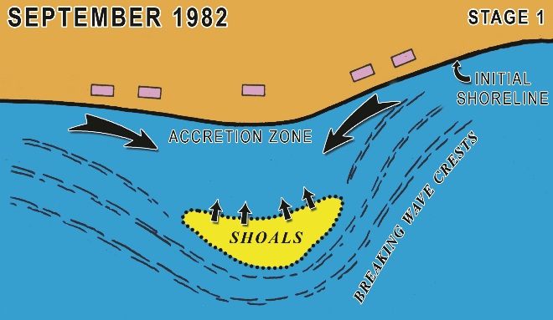
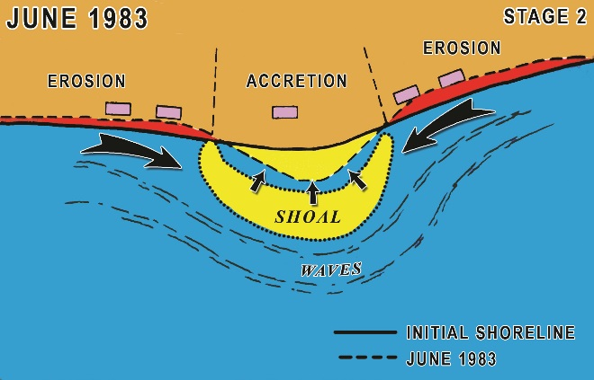
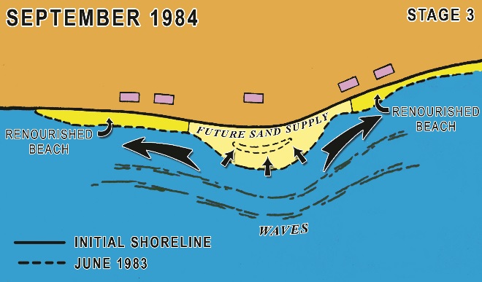
Kiawah Island
Key Recent Events
  Stono Inlet shoal attachment:
    Short-term (~1-2 yrs): accretion along Lagoon Reach, eastern portions of Ocean Course reach and western portions of Stono Inlet reach
    Longer-term (~@+ yrs): accretion along rest of Ocean Course and Stono Inlet reaches, gradual landward migration of high water line along Lagoon Reach

